Slide 1

Ratification Presentation
General Membership Meeting
MEA Headquarters
June 18, 2018

Slide 2
Recent Bargaining History:
Steps frozen in 2011
Planning time 2013
Hard cap increases continued each year
Modest off schedule stipends periodically
1% Aggregate on schedule two years ago

Slide 3
Goals of this Bargain:
Clarify Contract Language that was out of date
Adjust Contract Language for clarity
Retain Insurance Hard Cap and PAK B coverage
Address the calendar to align with current law
Restore YEARLY salary schedule movement!

Slide 4
Things the Team needed to consider:
School Fund Balance (the LSD savings)
Possible legislation changes for calendar
Prohibited topics
Per pupil increase
Law being considered for salary being based on merit/performance

Slide 5
Contract Edits:
Article 9
*A copy of each school/building discipline (i.e. office referral/incident) procedure will be completed and submitted to the head of the Instructional Division of the District within thirty (30) calendar days from the beginning of the school year. A copy of all schools/buildings discipline procedures shall be provided to the Association.

Slide 6
Contract Edits Continued
*Each school/building will jointly establish the process for administration to inform teachers of corrective action measures taken as part of the discipline procedures process
*If the request to remove a pupil is denied, the teacher shall have the right to appeal the decision to the Superintendent, or designee. The removal of a pupil is subject to the policies and procedures of the Board and Student Handbook.

Slide 7
Contract Edits Continued
*In the event that an employee has been threatened with harm and/or physically assaulted, the administration and employee will mutually discuss safeguards before the student is returned to class.

Slide 8
Contract Edits Continued
Clean up of language (Example: word “employee” versus many other terms)
SEIT Team: This is a Special Education Improvement Team that will function similar to School Improvement Team.
Co-curricular pay was based on $36, 262 it will now be based on the BA Level 1 rate
Insertion of LOA agreements

Slide 9
Calendar:
Five years
Added days to comply with the law
Starting prior to Labor Day (as is everyone in Ingham County)
3 “Walk away” half days included into calendar
3.5 hours duty time on class set up day
Day off before Spring Break vs Good Friday
3 day weekend in October

Slide 10
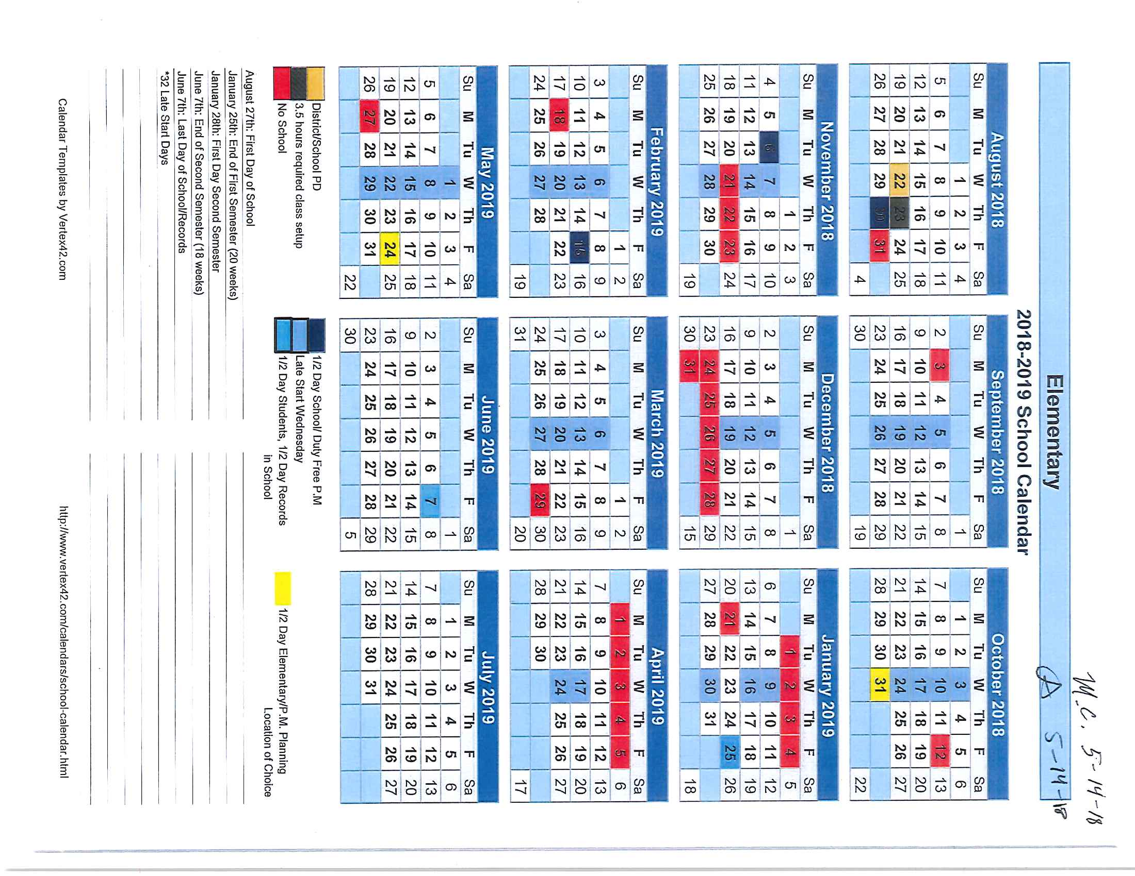

Slide 11
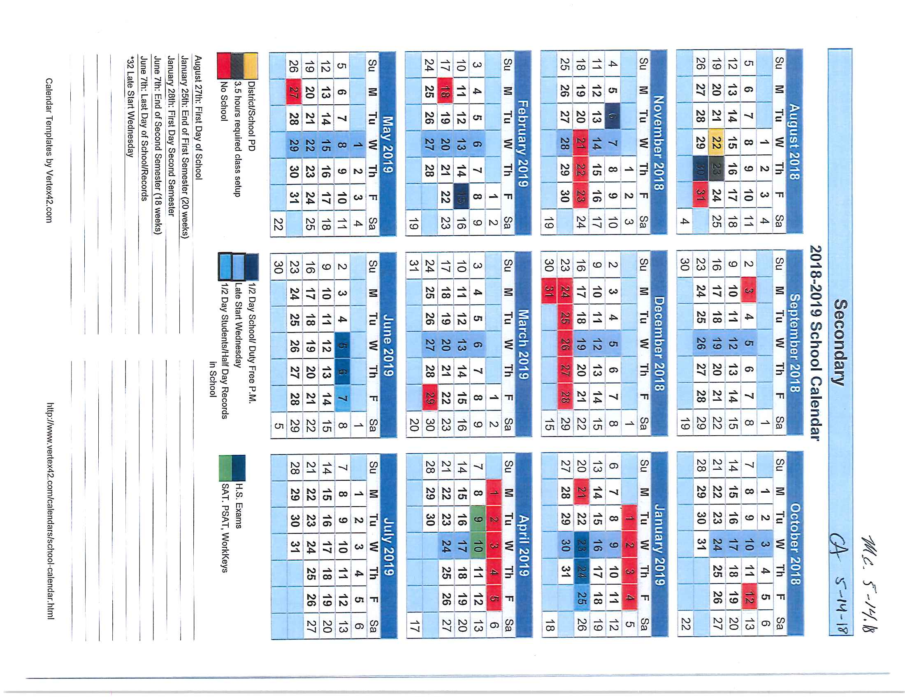

Slide 12
Current Salary Schedule for Salaried Staff:

Slide 13
Currently Salary Schedule Hourly:

Slide 14
How do we get moving again?
Must rethink what “steps” really meant and mean now
Become more competitive in Ingham County for starting and ending wages
Get creative!
Trust something new

Slide 15
Let’s get moving again!
Do you know your current Step?
Do not get “caught up” on the new number
Here we go…

Slide 16
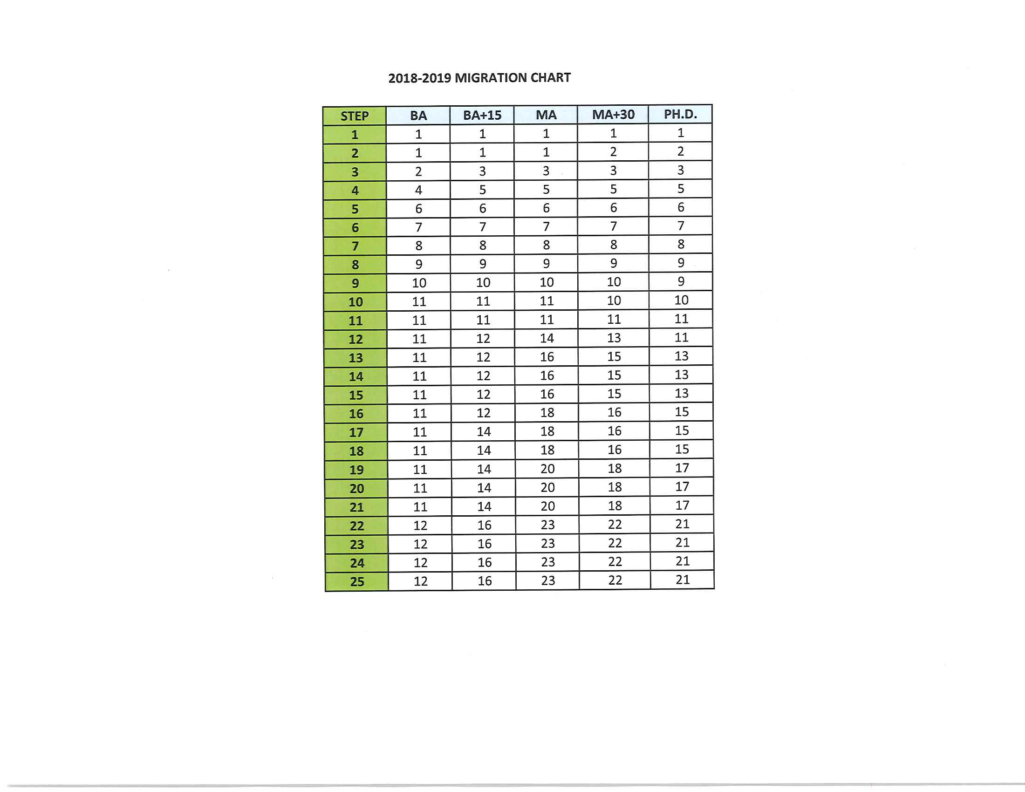
Migration Chart

Slide 17
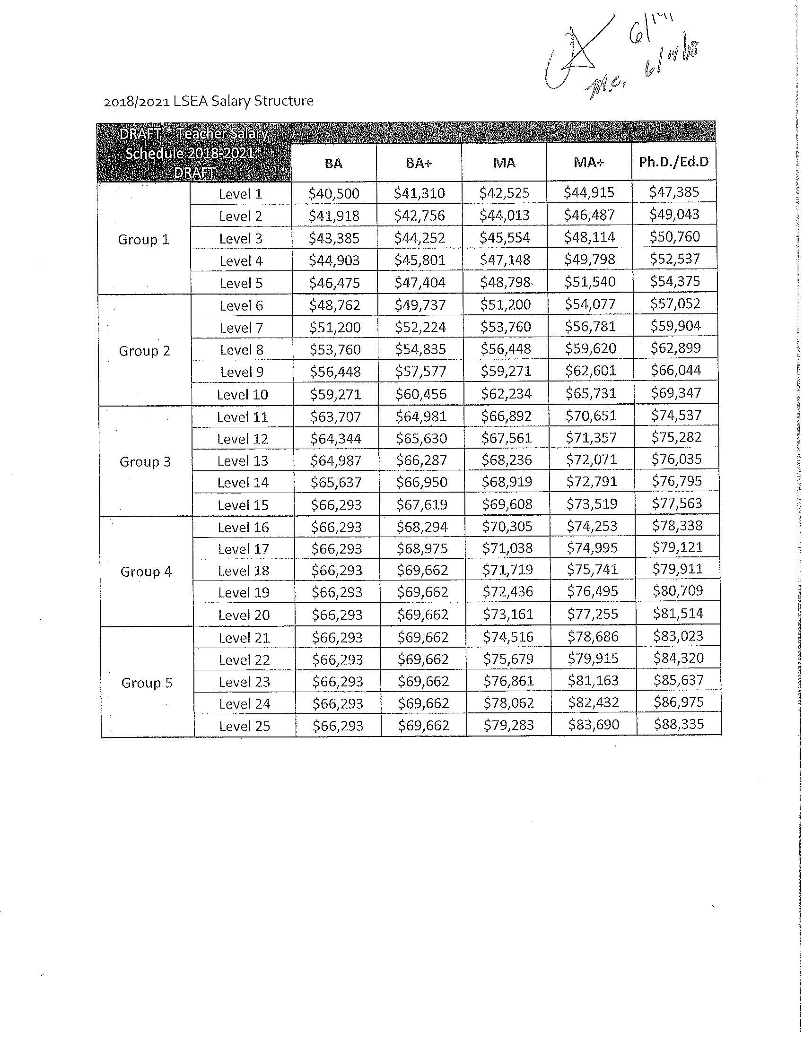
New Schedule

Slide 18
Let’s Dig a little deeper…
You will receive the full level each year for contract years one and two but we needed to get creative with the funding structure
Your level will be broken down into a semester 1 and semester 2 portion that will equal a full level within that year
This creates savings for the LSD to afford the movement at the beginning of the contract
This is what it will look like…

Slide 19
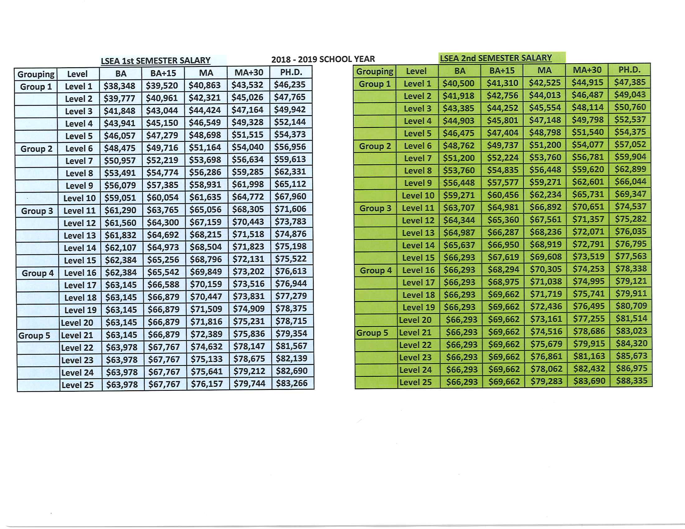

Slide 20
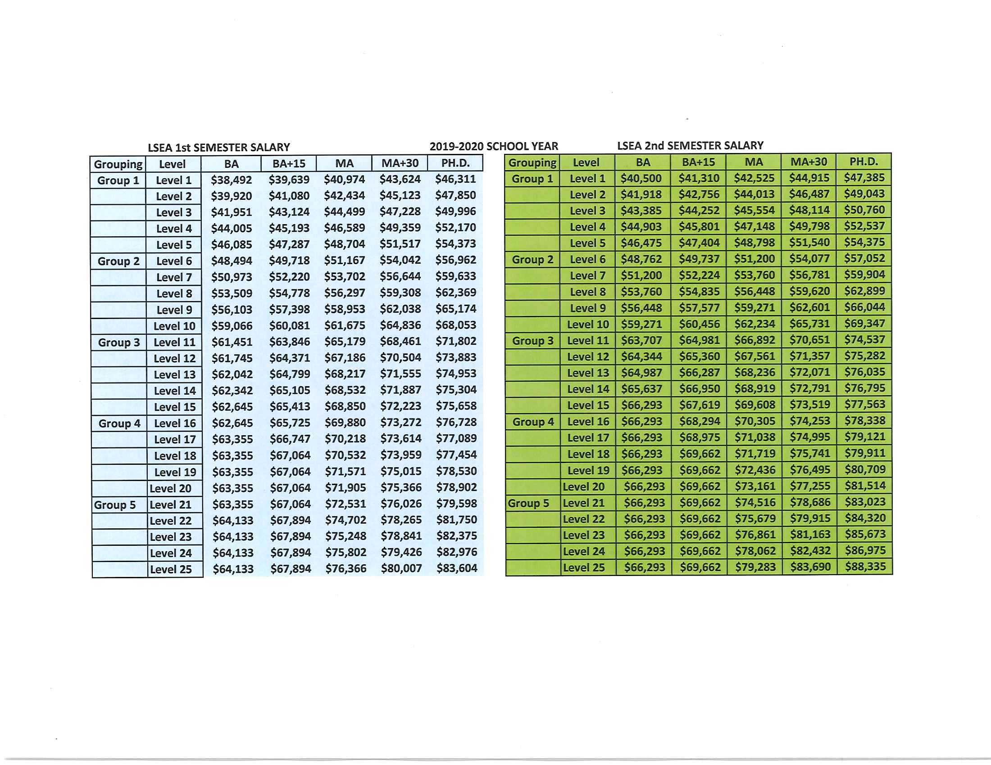

Slide 21
All Components of Salary TA
Salary Staff:
*All economics is for 5 years
*Salary employees will “migrate” to a new twenty-five level salary structure broken down into five groups
*In year one salaried employees will move to their new level based on a MINIMUM of a 2.5% salary increase

Slide 22
All Components of Salary TA Continued
*Years two through five salaried employees will move to the next level of the salary schedule
*Lanes will be granted all five years
*Those salaried employees that are to move beyond level twenty-five and have a Master’s Degree or higher will receive 1% off schedule stipend for each year of the agreement

Slide 23
All Components of Salary TA Continued
*For those salaried employees that have a BA or BA+15 that are to move beyond level twenty-five will receive a 0.5% off schedule stipend with a sunset clause of June 2023
*Limited financial opener for years four and five for percent increases for salary and hourly employees

Slide 24
All Components of the Salary TA Continued
*In years one and two the levels will be split into two half levels (based on semester) with each salaried employee reaching the full level at the end of the contract year. Semester salary schedules will be developed for these two years. Levels will return to the normal pay structure in the remaining years

Slide 25
All Components of the Salary TA Continued
Hourly:
*Increase hourly salary schedule to step seven cap and grant steps for the next five years of the agreement
*Once hourly employees advance beyond the seven steps, employees will receive 1% off schedule stipend

Slide 26
All Components of the Salary TA Continued
*Added Steps for hourly:

Slide 27
Benefits
The employer will pay the maximum employer contribution allowed under PA 152 for each year of the agreement
The employer will pay the maximum contribution allowed for PAK B for each year of the agreement

Slide 28
Compensable Leave
Each employee shall be entitled to up to seventy days of accumulation of compensable leave. Current and new employees may accrue compensable leave up to seventy days. Current employees shall keep the balance of their compensable leave if they have more than seventy days but not accrue additional days. If an employees compensable leave bank falls below seventy days they shall begin to accumulate days back up to seventy days.

Slide 29
Compensable Leave Continued
The employer shall pay Long Term Disability (66 2/3% monthly earnings value with a maximum of $4,000) beginning on day seventy-one for personal illness or injury
**Currently this begins on day 91 not 71

Slide 30
Compensable Leave Continued
Employees transferring in to the LSEA unit may transfer no more than seventy days of accumulated compensable leave time from their previous position and will then be capped at seventy days
Employees that are at or beyond the maximum days of compensable leave shall receive their allotment of twenty-one hours of personal leave time annually. These days will not convert to sick time at the end of the school year (if not used they will go away).

Slide 31
Additional Topics of TA
OT and PT employees that have achieved Master’s Level would be considered MA+ based on course requirements with supporting documentation
The duration of the agreement is five years
The duration of the agreement includes a five year calendar

Slide 32
Additional Topics of TA Continued
Task Force: Each task force below will include LSEA and administration representatives. The task force members will be selected by the LSEA President and the Superintendent or designee. Recommendations will be made to the Superintendent.

Slide 33
Additional Topics TA Continued
Planning Time: The stipend will remain as is, $5,000. The purpose of this task force is to investigate the concept of planning time. The task force should be creative in their approach and understand al budgetary implications.
Work Force: The task force will study ways to increase attendance, retain current teachers, recruit future teachers, and create a more positive working environment.

Slide 34
Additional Topics TA Continued
Ancillary Staff: The purpose of this task force is to make recommendations regarding the ancillary evaluation tool and process.

Slide 35
What is next?
Voting opened at 10am this morning (Monday) and will conclude at noon on Thursday, June 21st
Voting will take place online at www.lsea.org after using your member sign in information
All documents, including this PowerPoint will be online as well
School Board will take action this Thursday evening if this is approved by LSEA

Slide 36
Questions?

Slide 37


